Slide 1


Slide 2


K Nearest Neighbour ALGORITHM

Slide 3
TO
Balakrishnan Sir
Bharat Jain (19030141010)
Deeksha Tiwari (19030141014)
Manan Jain (19030141034)
Puja Jha (19030141050)
Stuti Singh (19030141072)

Slide 4


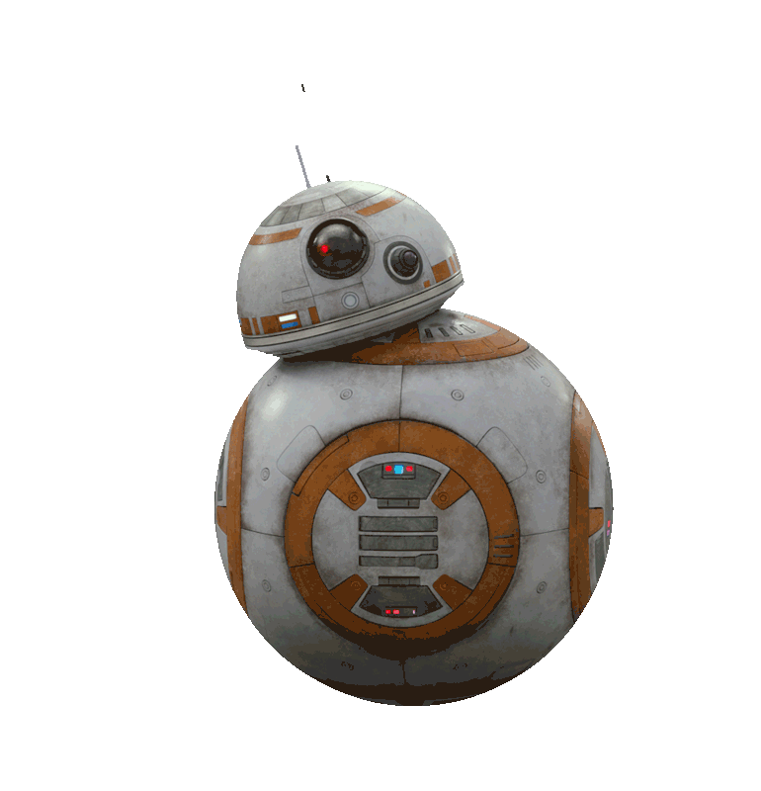
“K Nearest Neighbour is a simple algorithm that stores all the available cases and classifies the new Data or Case based on a Similarity Measure”
What is
KNN Algorithm
“KNN Algorithm is a non-parametric method used for CLASSIFICATION and REGRESSION.”

Slide 5






1st Property
Lazy Learning Algorithm
because it does not have a specialized training phase and uses all the data for training while classification.
2nd Property
Non-Parametric Learning Algorithm
because it doesn’t assume anything about the underlying data.
Properties of
KNN Algorithm
3rd Property
k-NN Classification
the output is a class membership. An object is classified by a plurality vote of its neighbors
4th Property
k-NN Regression
the output is the property value for the object. This value is the average of the values of k nearest neighbors
5th Property
Instance Based Learning
instead of performing explicit generalization, compares new problem instances with instances seen in training, which have been stored in memory

Slide 6
“It is called LAZY not because of its apparent simplicity, but because it doesn't learn a discriminative function from the training data but memorizes the training dataset instead.”
BUT WHY
KNN is Called Lazy Learner
It’s Processing differs with respect to K value
Result is generated after Analysis of Data
Neglects any Intermediate Value
It does not discriminates between Training Data but it memorizes The training Data
There is no learning phase of Training Model

Slide 7
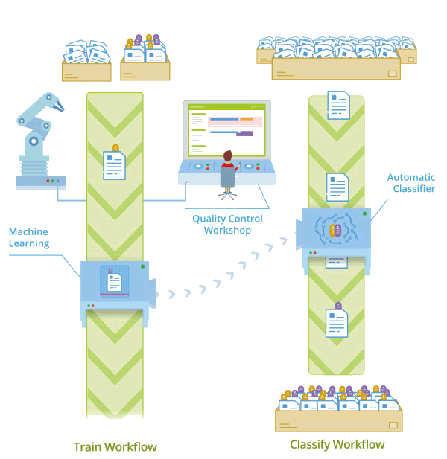
Industrial Application
of KNN Algorithm

Slide 8

Industrial Application
of KNN Algorithm

Slide 9

Industrial Application
of KNN Algorithm

Slide 10



Industrial Application
of KNN Algorithm

Slide 11
Requirements:
The value of K, the number of nearest neighbors to retrieve
Distance Metric to compute distance between records
The set of stored records
To classify an Unknown Record:
Compute distance to other training records
Identify K Nearest Neighbors
Use class labels of nearest neighbors to determine the class label of unknown record (e.g., by taking majority vote)
Requirements
&
Classification

Slide 12
The K in K Nearest Neighbors Algorithm uses a very simple approach to perform Classification.
When tested with a new example, it looks through the training data and finds the K training examples that are closest to the new example. It then assigns the most common class label (among those kk training examples) to the test example.
K is therefore just the number of neighbors "voting" on the test example's class.
If K = 1, then test examples are given the same label as the closest example in the training set.
If K = 3, the labels of the three closest classes are checked and the most common (i.e., occurring at least twice) label is assigned, and so on for larger Ks. When you build a K-Nearest Neighbor Classifier, you choose the value of K. You might have a specific value of K in mind, or you could divide up your data and use something like cross-validation to test several values of K in order to determine which works best for your data. For n = 1000 cases, I would bet that the optimal K is somewhere between 1 and 19, but you’d really have to try it to be sure
What does K
represents In KNN Algorithm

Slide 13
CLASS A
CLASS B
What does K
represents In KNN Algorithm

Slide 14
CLASS A
CLASS B
What does K
represents In KNN Algorithm

Slide 15
CLASS A
CLASS B
What does K
represents In KNN Algorithm
K = 3

Slide 16
CLASS A
CLASS B
What does K
represents In KNN Algorithm
K = 6

Slide 17
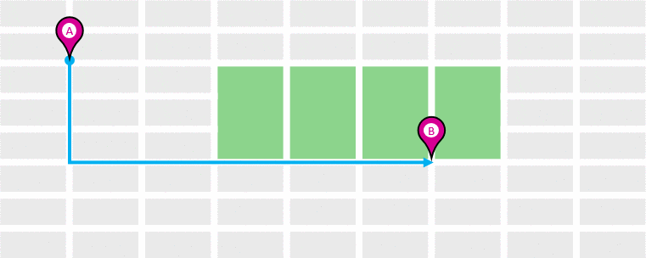

Euclidean Distance
How things are Predicted using KNN Algorithm
Manhattan Distance

Slide 18
0
1
2
3
4
5
0
Euclidean Distance &
Manhattan Distance
1
2
3
4
5

Slide 19
0
1
2
3
4
5
0
Euclidean Distance &
Manhattan Distance
1
Point P1 = (1,1)
2
3
4
5

Slide 20
0
1
2
3
4
5
0
Euclidean Distance &
Manhattan Distance
1
Point P1 = (1,1)
2
3
4
Point P2 = (5,4)
5

Slide 21
0
1
2
3
4
5
0
1
Point P1 = (1,1)
Euclidean Distance
2
5
3
4
Point P2 = (5,4)
5
Euclidean Distance = (5 – 1)² + (4 – 1)² = 5

Slide 22
0
1
2
3
4
5
0
1
Point P1 = (1,1)
Manhattan Distance
2
3
3
4
Point P2 = (5,4)
4
5
Manhattan Distance = |5 – 1| + |4 – 1| = 7

Slide 23
0
1
2
3
4
5
0
Euclidean Distance &
Manhattan Distance
1
Point P1 = (1,1)
2
5
3
3
4
Point P2 = (5,4)
4
5
Euclidean Distance = (5 – 1)² + (4 – 1)² = 5
Manhattan Distance = |5 – 1| + |4 – 1| = 7

Slide 24
0
1
2
3
4
5
0
1
2
3
4
5

Slide 25
0
1
2
3
4
5
0
1
2
3
4
5

Slide 26
0
1
2
3
4
5
0
1
2
3
4
5

Slide 27
0
1
2
3
4
5
0
1
2
5
3
4
5

Slide 28
0
1
2
3
4
5
0
1
2
3
3
4
4
5

Slide 29
0
1
2
3
4
5
0
1
2
5
3
3
4
4
5

Slide 30
